Slide 1



Data Exploration with Python
AI generated
The young researcher’s toolkit

Slide 2
Why Python?
Easy to use
Common in scientific setting
Lot of 3rd party support
Works on Linux, MacOS and Windows
General purpose
Automating (Ansible)
Web application (streamlit)
Machine and Deep Learning (Keras & PyTorch)
Data analysis & visualization (Pandas, Plotly)
Game development (Pygame)
Notes:
Dirk

Slide 3
Similar languages
R
Not a general purpose language
Focused more on scientific applications like statistics, algebra, machine learning
Ruby
Not much support for scientific libraries
Notes:
Dirk

Slide 4
What you will learn today
Basic idea how to use Python
Installation
Syntax & semantic
Structure & concepts
Installation and management of (scientific) dependencies
First exploration of a dataset
Notes:
Dirk

Slide 5

Installation: Anaconda
Conda: https://docs.conda.io/projects/conda/en/stable/user-guide/install/index.html

Slide 6




Installation: VSCode
Integrated development environment (IDE)
Visual Studio Code: https://code.visualstudio.com/Download
Extensions
https://marketplace.visualstudio.com/items?itemName=ms-python.python
https://marketplace.visualstudio.com/items?itemName=ms-python.vscode-pylance
https://marketplace.visualstudio.com/items?itemName=ms-toolsai.jupyter
Notes:
Dirk & Maike

Slide 7

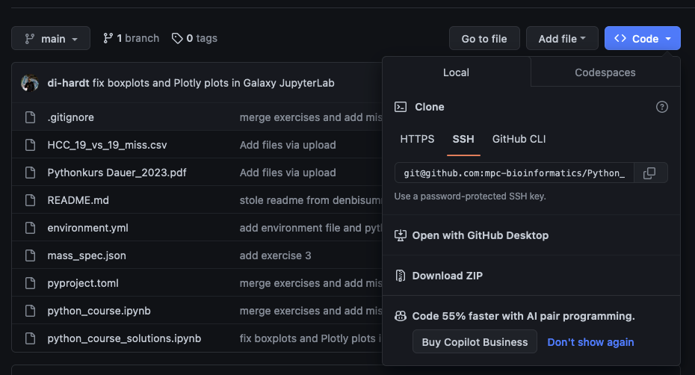
Download the prepared repository
https://l.rub.de/d291640f

Slide 8
Installation: Create the environment for today
Python: Open a Terminal (Linux/Mac) or CMD (Windows) and type
conda create -n cubimed_rub_python_course
conda activate cubimed_rub_python_course
conda install python=3.11
Notes:
Dirk & Maike

Slide 9
Installation: Create the environment for today
environment.yml
name: cubimed_rub_python_course
channels:
- defaults
- bioconda
- conda-forge
dependencies:
- python=3.11
- setuptools
# here we install the software using, `pip` the Python package manager
- pip
# this calls pip to install the necessary Python packages
# it basically searches in the current directory for one of the supported requirements files
# we use the new modern pyproject.toml file
- pip:
- -e ./
Notes:
Dirk & Maike

Slide 10
Installation: Create the environment for today
environment.yml - Looks software up in the default channels of Conda
Installable via: conda env create –f environment.yml
Usefull channels
`bioconda` - Biology related software (also Proteomics related)
`conda-forge` - Various software like compilers, libraries etc

Slide 11
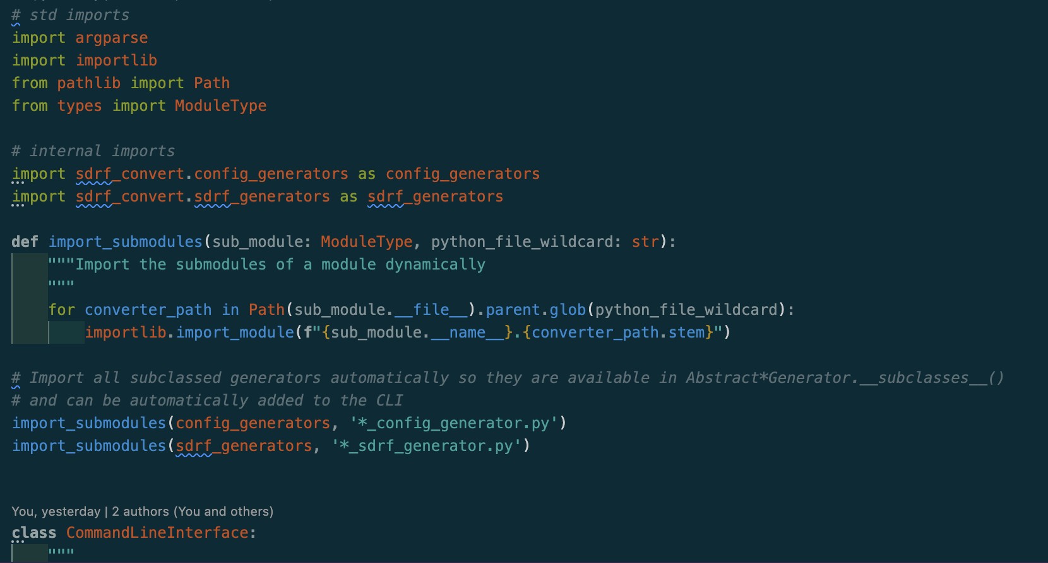
Source file
Normally your code lives in Python files ending with .py
Which are executed using the command: python do_what_i_say.py
Python starts to execute the first line and goes through the file line by line
Notes:
Dirk & Maike

Slide 12
Jupyter Notebooks
Jupyer Notebooks are a frontend for combining code and text blocks
They can display results immediatly (plots, tables, text)
Export to PDF, HTML, TeX, ...
Runs
Visual Studio Code (local)
Galaxy (Browser)
Which basically starts Jupyter Lab (self hosted / browser)
Google Colab
Notes:
Dirk & Maike

Slide 13
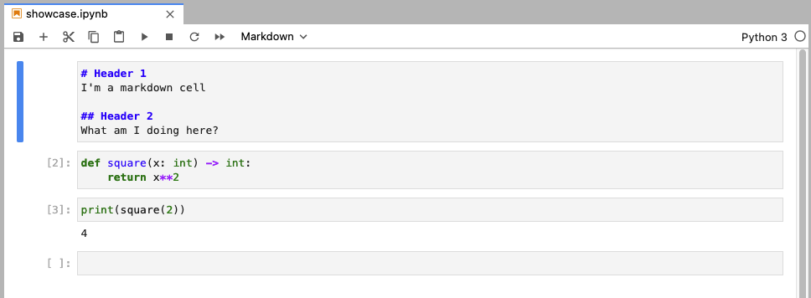
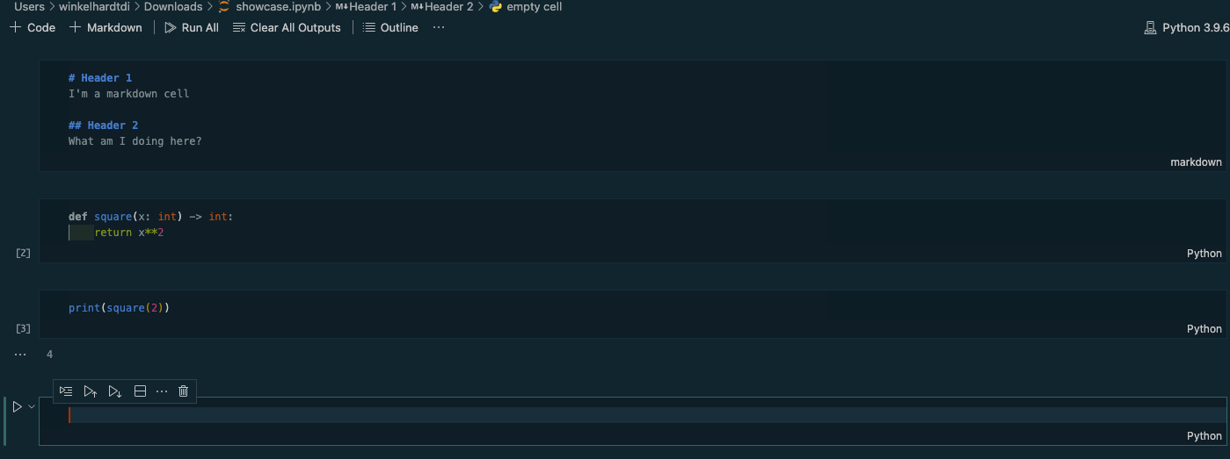
Jupyter Notebooks
Jupyter Lab (browser)
Visual Studio Code (local)
Notes:
Dirk & Maike

Slide 14
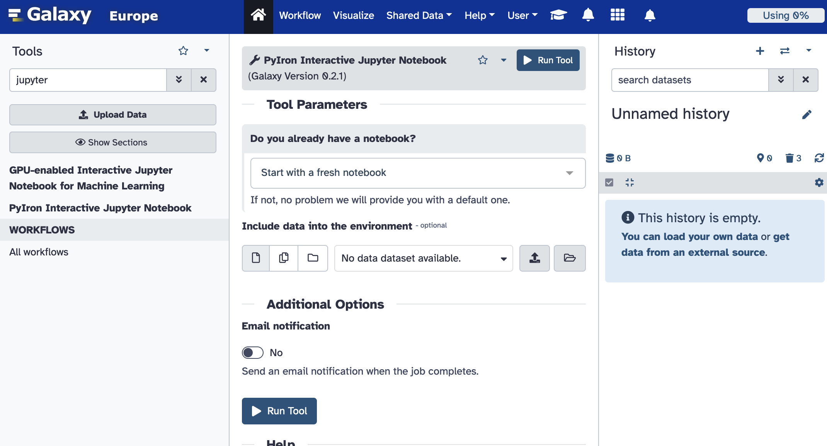


Jupyter Notebooks in Galaxy
Go to usegalaxy.eu and log in
Left side: Search for jupyter
Left side: Click on PyIron Interactive Jupyter Notebook
Middle: Click Run Job
Right side: Wait until PyIron Notebook becomes orange then click on the eye symbol
2.
5.1.
3.
4.
5.2.
Notes:
Dirk & Sebastian
https://training.galaxyproject.org/training-material/topics/data-science/tutorials/python-basics/tutorial.html

Slide 15
Primitive data, standard operators and comments
Primitive datatypes
Type | Description | Examples
Integer |  | ... -2, -1, -0, -1, -2 ...
Float | Numbers of various precision (rounding errors included) | ..., -0.2, 0.0001, 0.0, 0.3, 0.333335, ...
Boolean | Value about truthiness | True & False
Notes:
Dirk

Slide 16
Primitive data, standard operators and comments
Standard operator
Operator | Usage | Examples
Assignment | = | i = 1
Equals | == | 1 == 1
Not equals | != | 1 != 2
Notes:
Dirk

Slide 17
Primitive data, standard operators and comments
Numeric standard operator
Operator | Usage | Examples
Addition | + | 1 + 1 == 2
Substraction | - | 1 - 1 == 0
Multiplication | * | 2 * 3 == 6
Division | / | 6 / 3 == 2
Modulo | % | 5 % 2 == 1
Exponential | ** | 5 ** 3 == 125
Notes:
Dirk

Slide 18
Primitive data, standard operators and comments
Boolean standard operator
Operator | Usage | Examples
and | and | True and True == True True and False == False False and True == False False and False == False
or | or | True or True == True True or False == True False or True == True False or False == False
negation | not | not True == False not False == True not not True == True not not not not not True == False
Notes:
Dirk

Slide 19
Syntax
# This is a comment, it‘s start with ‚#‘ and is not evaluated by Python
“““
This is also a comment but spanning over
multiple lines
“““
# Your future you will appreciate to see some of them in your code ... Believe me
x = 1 # This is an assignment/declaration
y = 3 # This is also an assignment/ declaration
x + y # This is an operation, adds y to x
z = x + y # operation and assignment/declaration
print(“z is:”, z)
=> z is: 4
Notes:
Dirk

Slide 20
Exercise 1
Open the downloaded folder in Visual Studio Code
Now we do a few steps together. After each step raise your hand to show you’re ready!
https://l.rub.de/d291640f

Slide 21
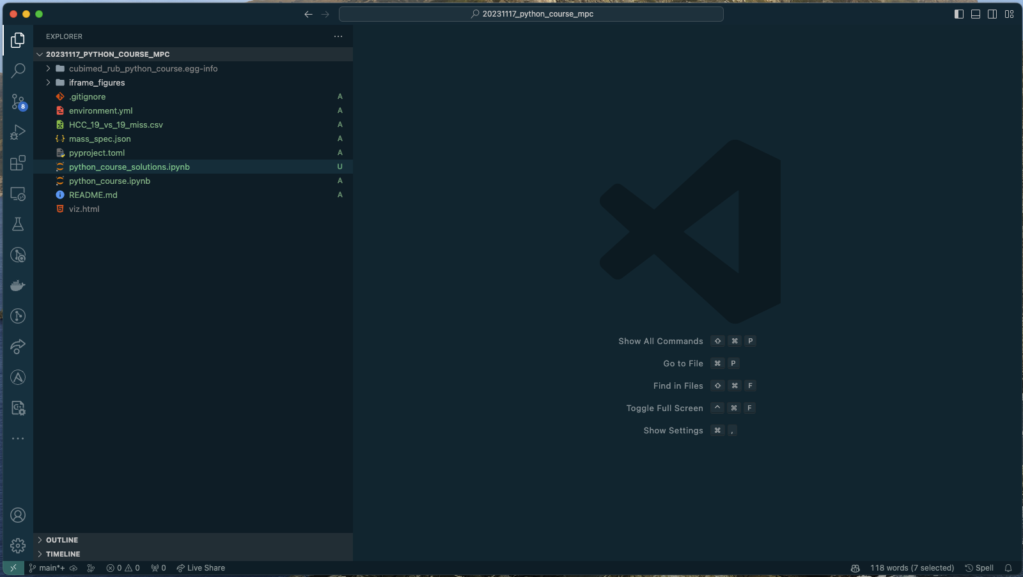
Exercise 1

Slide 22
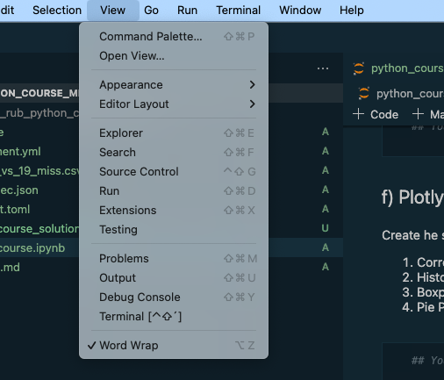
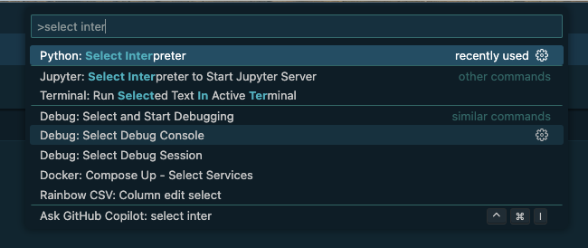
Exercise 1
View / Command pallete
Open the command pallete
Type in: `select inter` and select `Python: Select interpreter`
https://l.rub.de/d291640f

Slide 23
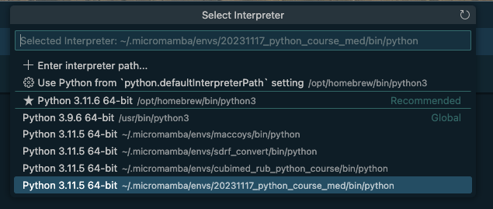
Exercise 1
Your environments interpreter should be listed as …/python_course/bin/python
Open python_course.ipynb
https://l.rub.de/d291640f

Slide 24
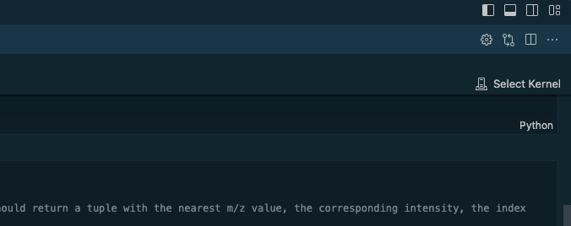
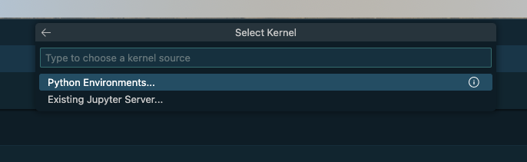
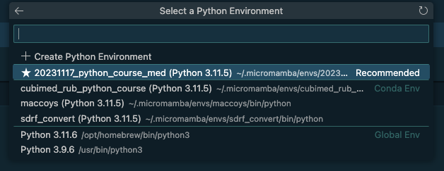
Exercise 1
Select your kernel
Python environment
Your selected python environment should be listed
Upper right corner
https://l.rub.de/d291640f
Python env

Slide 25
Exercise 1
Select your kernel
Python environment
Your selected python environment should be listed
Upper right corner
https://l.rub.de/d291640f
Python env

Slide 26
Exercise 1
Happy coding!!!
https://l.rub.de/d291640f

Slide 27
Functions
Represents a calculation / method / process / user interaction ...
Reusable
argument list, arguments also in lower_snake_case
function name in lower_snake_case
type of return (optional)
keyword
def i_am_a_function(arg_1: int, arg_2: float = 0.1) -> float:
# something is happening here
#
...
return some_var
function body
4 spaces, not 1 tab, not 2 spaces
optional default value
Notes:
Maike

Slide 28
Functions
Built-in functions
pow(base, exp, mod=None) - Returns base to the power of exp
round(number, ndigits) - Rounds number to ndigits, if ndigits is None (default) it rounds to nearest integer
print(*objects, sep=' ', end='\n', file=None, flush=False) - Prints the given objects, using the provided separator and end character. file & flush is for advanced purpose.
More: https://docs.python.org/3/library/functions.html
Notes:
Brings me to a very important part of software development

Slide 29

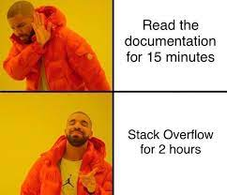


RTFM – Read the ******* manual (docs)
You can find the Python documentation here: https://docs.python.org/3/
!!! https://en.wikipedia.org/wiki/RTFM !!!

Slide 30
Function usage
print(“I am“, “Groot“)
=> “I am Groot“
print(“I am“, “Groot“, sep=“__“)
=> “I am__Groot“
round(3.14159265359)
=> 3
round(3.14159265359, 2)
=> 3.14
pow(2, 3)
=> 8
# save the result of a function
res = pow(2,3)
Notes:
Maike

Slide 31
Imports
Python contain more functionality then the built-in function and additional constants like the number Pi
Make them accessible via imports
Sweetviz mit reinnehmen (läuft auf jupypternoteboo)
import math
import random
print(math.pi)
=> 3.141592653589793
math.ceil(math.pi)
=> 4
random.randint(1, 10)
=> ???
Notes:
Dirk & Maike

Slide 32
Complex data types & data collections
Type | Description | Examples
List | A list of elements | [1,2,3,4,5], [„I“, „am“, „Groot“], [True, False, True, True]
String | List of character or simply: a text. | „“I am Groot“
Tuple | Immutable list of elements | (1,2,3,4), („I“, „am“, „Groot“), („only one element requires a comma at the end“,)
Set | A list of unique elements | {„Every“, „value“, „only“, „once“}
Dictionary | A list of key-value pairs. Each key is unique. | {„DS9“: „Deep Space 9“, „Greece“: „Athen“, 1: 4, „a list“: [1,2,3,4,5]}
https://docs.python.org/3/tutorial/datastructures.html
Notes:
Dirk & Maike

Slide 33
Complex data types & data collections
a_list = [1, 2, 3, “4”]
# zero based indexing
print(a_list[0])
=> 1
# we can append new elements
a_list.append(5)
print(a_list)
=> [1, 2, 3, “4”, 5]
# removing the first element
a_list.pop()
https://docs.python.org/3/tutorial/datastructures.html#more-on-lists

Slide 34
Complex data types & data collections
a_dict = {“Groot” : “I am Groot”, ”This is”: ”Sparta”, 7: “of 9?”}
# Accessing by key
print(a_dict[“Groot”])
=> I am Groot
print(a_dict[7])
=> of 9?
# Adding a new element
a_dict[“Yoda”] = ”Do or do not, there is nor try”
# Removing an element
a_dict.remove(“Yoda”)
https://docs.python.org/3/tutorial/datastructures.html#dictionaries

Slide 35
Exercise 2
https://l.rub.de/d291640f

Slide 36
Control flow
if-else-statement
if-elif-else-statement
surname = input(“Enter surname:“)
if surname[0].lower() < “m”:
print(“Your case worker is Person X”)
else:
print(“Your case worker is Person Y”
surname = input(“Enter surname:“)
if surname[0].lower() < “j”:
print(“Your case worker is person X”)
elif surname[0].lower() >= “j” and surname[0].lower() < “q”:
print(“Your case worker is person Y”)
elif ... :
else:
print(“No idea who your case worker is: ¯\_(ツ)_/¯ ”
Notes:
Maike

Slide 37
Control flow
match-statement
Introduced in Python 3.10
def get_mass_of_amino_acid(amino_acid: str) -> float:
match amino_acid.lower():
case “a”:
return 71.037113805
case “c”:
return 103.009184505
...
case “w”:
return 186.079312980
case _:
# Default case
raise Error(f”’{amino_acid}’ not found”)
Notes:
Oops an error! Transition to try-catch

Slide 38
Control flow
try-catch-statement
amino_acid = input(“Amino acid: “)
try:
get_mass_of_amino_acid(amino_acid)
except Error as err:
print(“Oops! Something went wrong. You might want to have a look:”, err)
Notes:
Maike

Slide 39
Control flow
Loops
You can skip a step in the loop by calling continue
Leaving a loop is possible with break
# Simple for loop counting from 0 to 9
for i in range(10):
print(i)
# A while loop repeats until a given condition is false
i = 0
while i < 10:
print(i)
i += 1
Notes:
Maike

Slide 40
Control flow
Loops
Types which can be iterated called iterables!
numbers = [1,2,3,4,5,6,7,8,9,110]
for i in numbers :
print(i)
Notes:
Querstion: What will be printed when iterating a dict?

Slide 41
Control flow
Loops
dictionary = {“I am”: “Groot”, “This is”: “Sparta”}
for i in dictionary:
print(i)
dictionary = {“I am”: “Groot”, “This is”: “Sparta”}
for k, v in dictionary.items():
print(k, v)
Notes:
Querstion: What will be printed when iterating a dict?

Slide 42
Exercise 3
https://l.rub.de/d291640f

Slide 43
Unleash the force: The light side
Next to the built-in functions and modules you can use 3rd party imports
You need to install them first
You can find them
Python Package Index https://pypi.org/
GitHub (you can install directly from a repository)
Be aware that this packages can also contain harmful code
Never install a package from a ZIP archive or similar
Look up the developers on GitHub
Check the stars on GitHub
> pip install <PACKAGE_NAME>
Notes:
Übergang zu Pandas

Slide 44
Unleash the force: The dark side
import argparse
from datetime import datetime, timedelta
from io import IOBase
from typing import ClassVar, Dict, Iterator, List, Tuple, Type, Union
import pandas as pd
from pathlib import Path
from pyteomics import mass
import re
from sdrf_convert.abstract_converter import AbstractConverter
import xml.etree.ElementTree as ET
What is the problem here?
Notes:
Übergang zu Pandas

Slide 45
Unleash the force: The dark side
# std imports
import argparse
from datetime import datetime, timedelta
from io import IOBase
from typing import ClassVar, Dict, Iterator, List, Tuple, Type, Union
from pathlib import Path
import re
# 3rd party imports
import pandas as pd
from pyteomics import mass
import xml.etree.ElementTree as ET
# local import
from sdrf_convert.abstract_converter import AbstractConverter
Notes:
Übergang zu Pandas

Slide 46
Unleash the force: Tame the dark side
astroid==3.0.1
dill==0.3.7
greenlet==3.0.1
isort==5.12.0
lxml==4.9.3
mccabe==0.7.0
numpy==1.26.1
pandas==2.0.3
platformdirs==3.11.0
pylint==3.0.2
pyteomics==4.6.3
python-dateutil==2.8.2
pytz==2023.3.post1
-e git+ssh://git@github.com/di-hardt/sdrf_convert.git@d2c570754dbf8939cd1c35de3a55628697a0e48f#egg=sdrf_convert
six==1.16.0
SQLAlchemy==2.0.23
tomlkit==0.12.2
typing_extensions==4.8.0
tzdata==2023.3
Old school: requirements.txt contains direct and indirect dependencies (or sub dependencies)
Why could this be a problem?
Notes:
Übergang zu Pandas

Slide 47
Unleash the force: Tame the dark side
[build-system]
requires = ["setuptools", "wheel"]
[project]
name = ”<SOME_NAME>"
version = "0.0.1"
requires-python = ">=3.11"
dependencies = [
"pandas >= 2, < 2.1.0",
"pyteomics >= 4.6, < 5",
"lxml >= 4.9.3, < 5",
"sqlalchemy >= 2, < 3",
]
[project.optional-dependencies]
dev = [
"pylint"
]
The newest way: pyproject.toml contains direct and indirect dependencies (or sub dependencies)
Don’t put them in the conda’s environment.toml
Notes:
Übergang zu Pandas

Slide 48
Unleash the force: Tame the dark side
# Install a requirements.txt
pip install –r requirements.txt
# Install a pyproject.toml
pip install <FOLDER_WHERE_PYPROJECT_TOML_IS_LOCATED>
Notes:
Übergang zu Pandas

Slide 49
Object oriented programming
How would YOU represent a mass spectrum with m/z and intensities?
Nope.
Notes:
Übergang zu Pandas

Slide 50
Object oriented programming
Let‘s abstract something by creating a template, a so called class
class MassSpec:
# constructor
def __init__(self, mz: list, intensities: list):
self.mz = mz
self.intensities = intensities
def get_nearest_peak(self, target_mz: float) -> tuple:
# Dum dum dum du, dum du dum du duu (Jeopardy!-melody)
return (mz, intensity, index, distance)
Notes:
Übergang zu Pandas

Slide 51
Object oriented programming
Lets build some mass spectra from our template
# Create a mass spec
a_spec = MassSpec([103.4, ...], [3040, ...])
# Create another mass spec
another_spec = MassSpec([405.4, ...], [1000, ...])
# We can also arrange them in a list
mass_specs = [a_spec, another_spec]
# Or directly in a list
mass_specs = [
MassSpec([103.4, ...], [3040, ...]),
MassSpec([405.4, ...], [1000, ...]))
]
Notes:
Übergang zu Pandas

Slide 52
Object oriented programming
Lets play with out mass spectra
for spec in mass_specs:
# print mz
print(spec.mz)
# find nearest peak to 356.8 in all mass specs
print(spec.find_nearest_peak(356.8)
Notes:
Übergang zu Pandas

Slide 53
Object oriented programming
Working with objects before
List, dictionary, set, string
They just have special constructors
Notes:
Übergang zu Pandas

Slide 54

Pandas
Open source python package for data analysis
Used for data exploration, cleaning and transformation/manipulation
“… a more sophisticated Excel“
Works with data series (one dimensional array with indices) and dataframes (table 2D)
Pandas documentation can be found here: https://pandas.pydata.org/docs/index.html
And some starter tutorial: https://www.w3schools.com/python/pandas/default.asp
Notes:
Maike

Slide 55
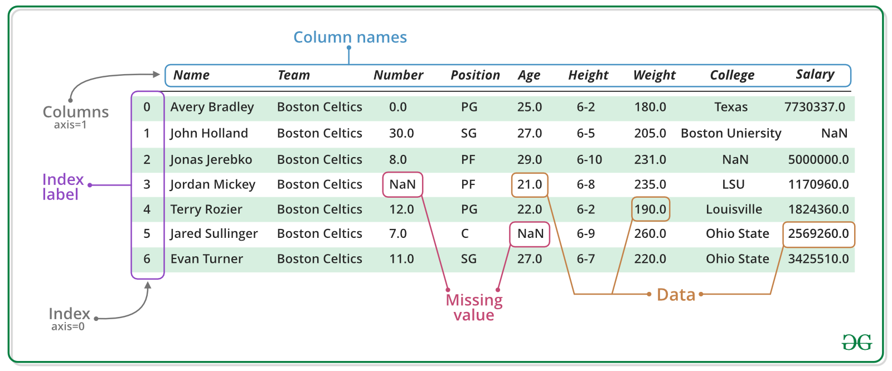
Pandas - Dataframe
Notes:
Maike

Slide 56
Pandas – load your data
Pandas supports reading of a variety of file formats like excel, csv, tsv, json, hdf, html, sql, .....)
We focus on the three most used:
Excel: df_sheet = pd.read_excel(„sample.xlsx“)
Csv: df_csv = pd.read_csv(„sample.csv“)
Json: df_json = pd.read_json(„sample.csv“)
The „read“ functions comes with a lot of parameters:
Excel: sheet_name(1) or sheet_name(“sheet_name1“) or sheet_name(None)
All: decimal = “,“ or decimal = “.“
Read all possibilities up in the docs!
s
# Excel
df_sheet = pd.read_excel(„sample.xlsx“)
# CSV
df_csv = pd.read_csv(“sample.csv“)
# JSON
df_json = pd.read_json(“sample.json“)

Slide 57
Pandas – check your data
Always check if your file was loaded correctly.
Either look at the whole dataframe:
Print(df)
But much more recommended:
Print(df.head()) (prints first 5 rows)
Check if the columns are right:
Print(df.columns)
Check what your dataframe contains:
Print(df.info())
print(df)
print(df.head()) # prints first 5 rows
print(df.columns)
print(df.info())
Notes:
Maike

Slide 58
Pandas - Dropping
Dropping missing values from the whole dataframe:
Df.dropna()
Drop missing values from specific columns:
df.dropna(subset = [„col1“, „col2“, „col3“, ...]
Remove all columns containing more than 20% NaNs
Df_20_missing = df.dropna(axis=1, thresh = int(0.2*df.shape[0])
Delete rows with specific value in a specific column:
New_df = df[df.column1 != 0]
Delete a specific column:
New_df = df.drop(„column1“, axis = 1)
df.dropna()
df.dropna(subset = [“col1“, “col2“, “col3“, ...])
df_20_missing = df.dropna(axis=1, thresh = int(0.8*df.shape[0]))
new_df = df[df.column1 != 0]
new_df = df.drop(„column1“, axis = 1)
Notes:
Maike (k-NN, random forest; MICE imputation wie macht man das in Python)

Slide 59
Pandas - Imputation
We can impute all missing values with the function fillna()
With scalar:
Df.fillna(0)
Df.fillna(„spongebob“)
With object:
Df.fillna(df.mean()) (median, sum, ,...)
df.fillna(0)
df.fillna(“spongebob“)
df.fillna(df.mean()) # (median, sum, ,...)
Notes:
Maike (k-NN, random forest; MICE imputation wie macht man das in Python)

Slide 60
Pandas - Correlation
Pandas can calculate correlation on the whole dataframe, automatically excluding all NA/null values
Different methods available: pearson , kendall and spearman
Returns a dataframe with the correlation matrix
Correlation within a dataframe:
Corr = df.corr(method=“pearson“, numeric_only=False)
Correlation with another dataframe:
Df.corrwith(df2, method=“pearson“, numeric_only = False)
In jupyter notebook, we can visualize the matrix as a heatmap with
Corr.style.background_gradient(cmap=“coolwarm“).set_precision(2)
corr = df.corr(method=“pearson“, numeric_only=False)
df.corrwith(another_df, method=“pearson“)
corr.style.background_gradient(cmap=“coolwarm“)
Notes:
Maike

Slide 61

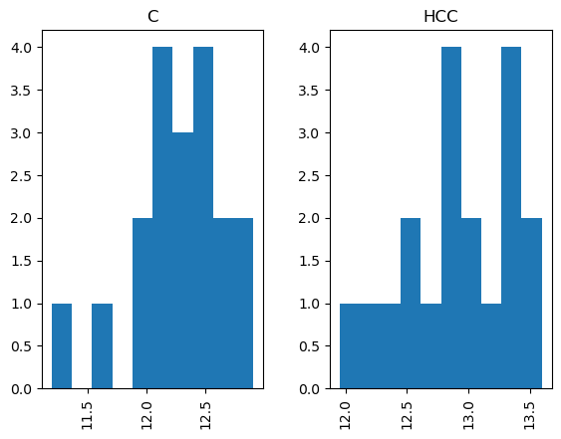
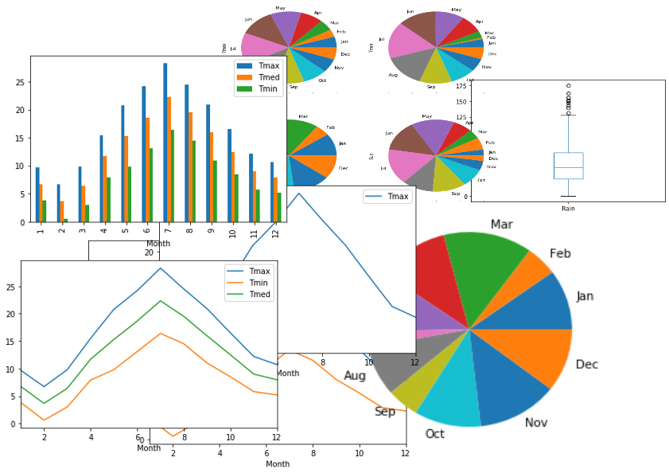
Pandas – Plots
Pandas supports multiple plot types like bar, hist, box, density, area, scatter and pie plots:
Df.plot.hist()
Df.plot.box()
Df.plot.scatter(x = „col1“, y = „col2“)
df.plot.hist() or df.hist()
df.plot.box() or df.boxplot()
df.plot.pie(subplots=True, figsize=(8,4));

Slide 62
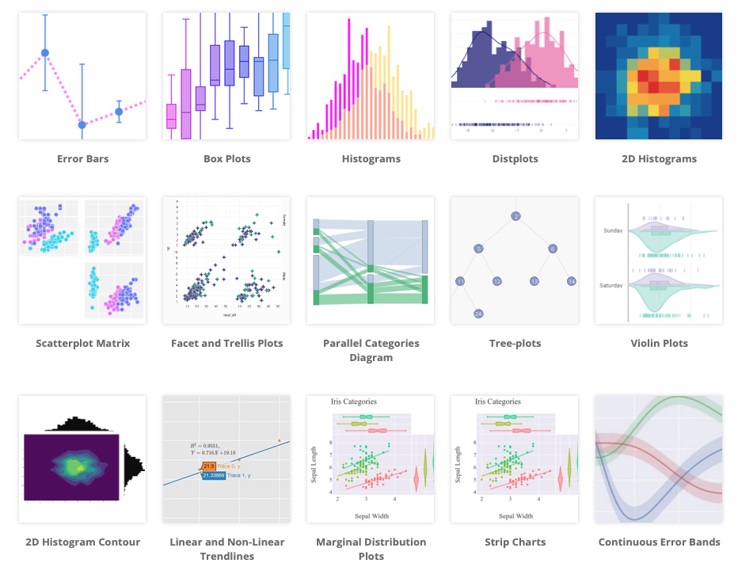
Plotly (Why? ´Cause it is beautiful)
Plotly is a graphical library that supports multiple programming languages like Python, R, Julia, Javascript, F#...
Can create
Interactive plots (Jupyter Notebook, HTML/JS)
Static images (SVG, PNG, JPEG, PDF, …)
JSON for interchange
Languages (Python ⬄ R)
Server ⬄ Client
Can also be created from gglots2!
Notes:
Dirk

Slide 63
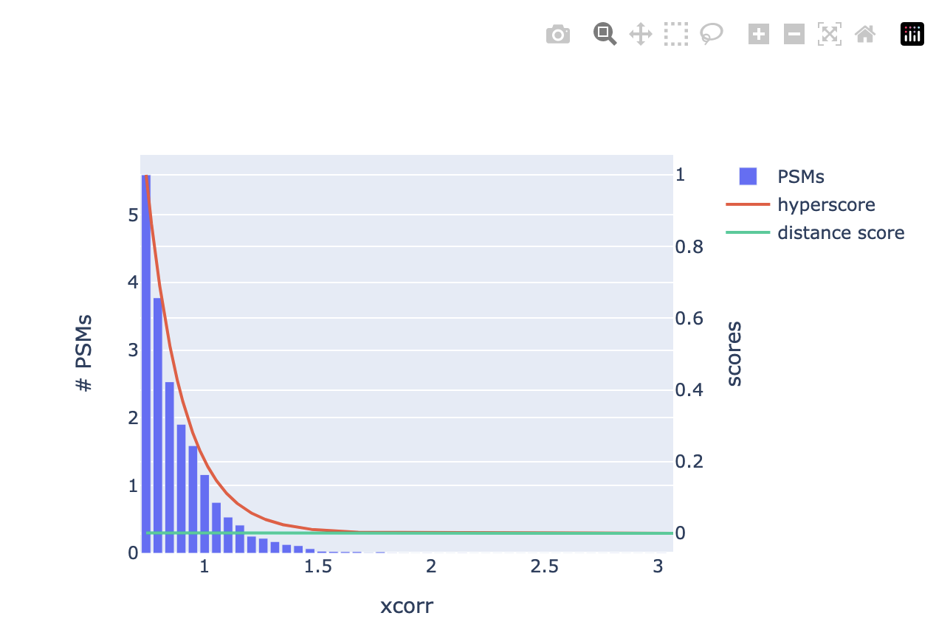
Plotly (Why? ´Cause it is beautiful)
Interactivity!
Controls (zoom, download, …)
Traces/ Datasets
Notes:
Dirk

Slide 64
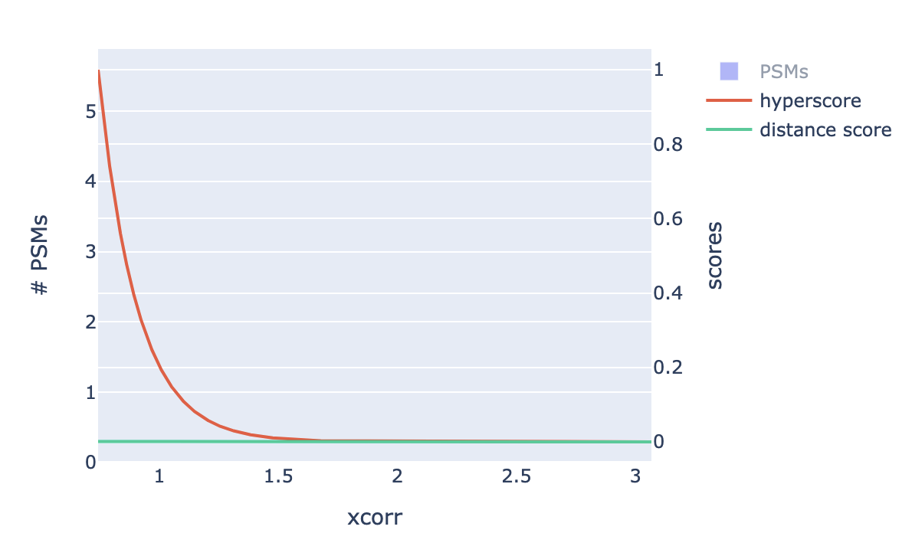
Plotly (Why? ´Cause it is beautiful)
Interactivity!
Disabled trace
Notes:
Dirk

Slide 65
Plotly (Why? ´Cause it is beautiful)
import plotly.graph_objects as go
fig = go.Figure()
fig.add_trace(go.Bar(
x = df[“a_col”],
y = df[“another_col”]
))
fig.show()
fig.write_image("fig1.png")

Slide 66
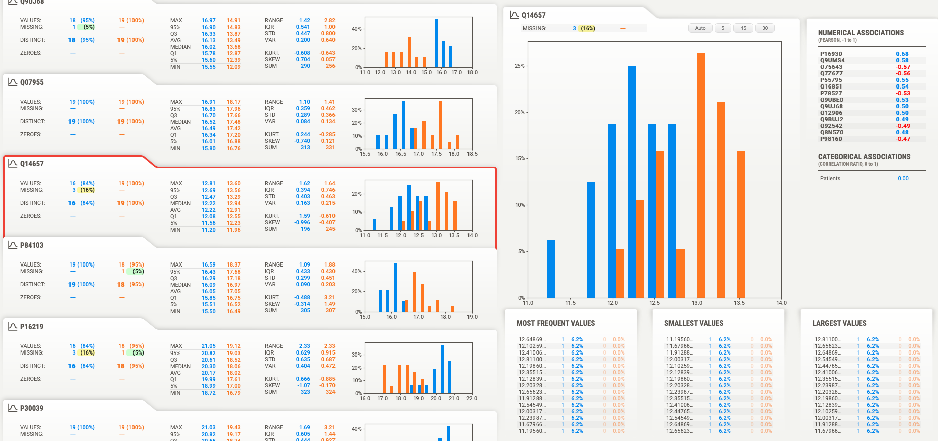
Sweetviz
Open-source Python library to „kickstart“ Exploratory Data Analysis (EDA)
High-density visualization
HTML or jupyter notebook
Compare 2 Dataframes or 2 subsets of the same dataframe
More libraries like this:
Dtale
Autoviz
YData Profiling

Slide 67
Exercise 4
https://l.rub.de/d291640f

Slide 68
Scientific libraries
scipy
Mathematical functions (algebra, interpolation, distributions, ...)
scikit-learn
„Classic“ machine learning (Random Forest, SVM, ...)
PyTorch / Keras
Deep Learning
Layers types: Dense, Convolution, LSTMs, …
Activation functions: ReLU, Sigmoid, …
Optimizers: SDG, Adam, Nadam, …
Notes:
Maike

Slide 69
Scikit-learn - preprocessing
Machine learning library for python
Split the data into a training and a test set:
Labels = df[„target_column“]
Features = df.drop(„target_column“, axis=1)
Sklearn.model.selection.train_test_split(features, labels, test_size=0.2,random_state=42)
Impute train and test set independently:
imputed_test = x_test.fillna(x_test.median())
imputed_train = x_train.fillna(x_train.median())
Notes:
Maike

Slide 70
Scikit-learn – random forest classification
clf = RandomForestClassifier(min_samples_leaf=MIN_SAMPLES_LEAF, min_samples_split=MIN_SAMPLES_SPLIT, n_estimators=N_ESTIMATORS, class_weight=CLASS_WEIGHT)
clf.fit(x_train, y_train)
probabilities = clf.predict_proba(x_test)
predicted = (probabilities[:,1] >= 0.5)
Check performance:
print(metrics.accuracy_score(y_val, predicted)
Notes:
Maike

Slide 71
Shifting gears - Rust integration
Why?
Python is slow!
No worries: It is actually as fast as an interpreter language can be and 1000x faster than you
Why is it so used for machine / deep learning
The real power of Python lies in native modules like Pandas, Numpy etc.
Written in C, C++ and Rust, which are?
Compiler languages!
Notes:
Dirk

Slide 72

Shifting gears - Rust integration
Interpreter language
They have advantages
Easy to program
Flexible
Able to reprogram itself during runtime
i = 1
i += 1
for x in range(10):
print(i**x)
Translate into intermediate format and compile it
Notes:
Dirk

Slide 73
Shifting gears - Rust integration
Compiler language
Strict
Typed
Once finished it is compiled into machine code
Need to be recompiled after changes
fn main() {
let mut i: i64 = 1;
i += 1;
for x in 0..10 {
println!(“{}”, i**x);
}
}
Notes:
Dirk

Slide 74
Shifting gears - Rust integration
Compiler language
Why not C or C++? Why Rust?
Speed is the same
Package ecosystem
https://crates.io (Python equivalent https://pypi.com)
cargo (Python equivalent: pip)
Memory safe
Notes:
Dirk

Slide 75
Python vs. Rust
i = 1
i += 1
for x in range(10):
print(i**x)
fn main() {
let mut i: i64 = 1;
i += 1;
for x in 0..10 {
println!(“{}”, i**x);
}
}

Slide 76
Preparation
Install rustup by following instructions on https://rustup.rs/
# Terminal
curl --proto '=https' --tlsv1.2 -sSf https://sh.rustup.rs | sh
rustup install stable
pip install maturin
apt update
apt install build-essentials

Slide 77
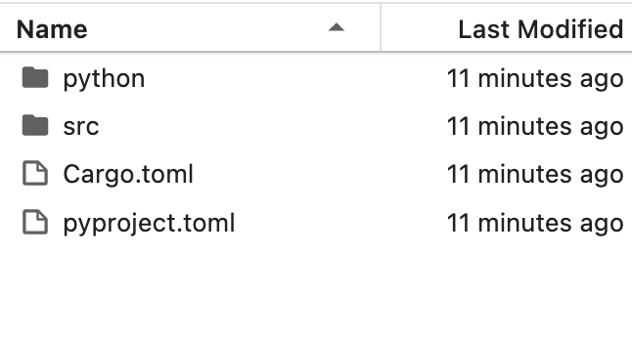
First we create a mixed project
# Terminal
maturin init denbi_summerschool2023_rs –mixed
# Select pyo3

Slide 78
First we create a mixed project
// src/lib.rs
use pyo3::prelude::*;
/// Formats the sum of two numbers as string.
#[pyfunction]
fn sum_as_string(a: usize, b: usize) -> PyResult<String> {
Ok((a + b).to_string())
}
/// A Python module implemented in Rust.
#[pymodule]
fn summerschoo2023_rs(_py: Python, m: &PyModule) -> PyResult<()> {
m.add_function(wrap_pyfunction!(sum_as_string, m)?)?;
Ok(())
}

Slide 79
Compile
# Terminal
maturin develop -r

Slide 80
Try it
Try it in a interactive Python shell
Just type python in your terminal
And type in
from summerschoo2023_rs import *
sum_as_string(1, 2)

Slide 81
Exercise 5
Reimplement the function from exercise 3 in Rust
https://doc.rust-lang.org/book/
https://pyo3.rs/v0.19.2/
Read the mass spectrum from exercise 3 again using Python and check if your Rust implementation works
Time your rust implementation

Slide 82

Exercise 5
https://l.rub.de/74423d59

Slide 83
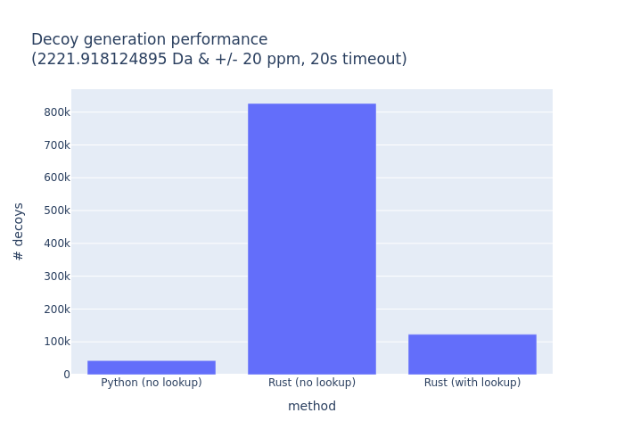
Is it really that fast?
Example: Decoy generator (random amino acid sequences)
Need 1000 decoys per target peptide
50000 – 350000 targets per spectrum
26000 spectra
1.300.000.000.000 decoys

Slide 84
Where to go?
Get more proficient in object oriented programming
Dataclasses & slots
Properties
Dependency management
You need to make your code installable and reproducible. Very important for reviewers
GIT
Helps you to keep track of your changes as code will improve iteratively
Make your code collaboratively available on GitHub / GitLab etc.
The wrong way: Nextcloud, Google Cloud, Dropbox, Word …
Notes:
Dirk

Slide 85
Where to go?
(Unit-) Tests
Automatic tests will help you keep your code functional after changes
Practice practice practice
Automate small task
Leet code: https://leetcode.com/
Provides you with small code challenges and checks your results
Notes:
Dirk

